Slide 1

Mene, Mene, Tikel, Parin
Daniel Chapter 5

Slide 2
“Those who have long enjoy such privileges as we enjoy forget in time that men have died to win them.”
President Franklin D Roosevelt

Slide 3
They lost all sense of remembrance.
They lost all sense of reality.
They lost all sense of restraint.
And, they lost all sense of respect.

Slide 4
The Danger of Losing
All Sense of Remembrance
Daniel 5:18-23

Slide 5
“Those who walk in pride He is able to put down”.
Daniel 4:37

Slide 6
“Is not this great Babylon, that I have built for a royal dwelling by my mighty power and for the honor of my majesty?"
Daniel 4:40

Slide 7
“Those who walk in pride He is able to put down”.
Daniel 4:37

Slide 8
“A nation which does not remember what it was yesterday, does not know what it is today, nor what it is trying to do. We are trying to do a futile thing if we do not know where we came from or what we have been about.”
President Woodrow Wilson

Slide 9
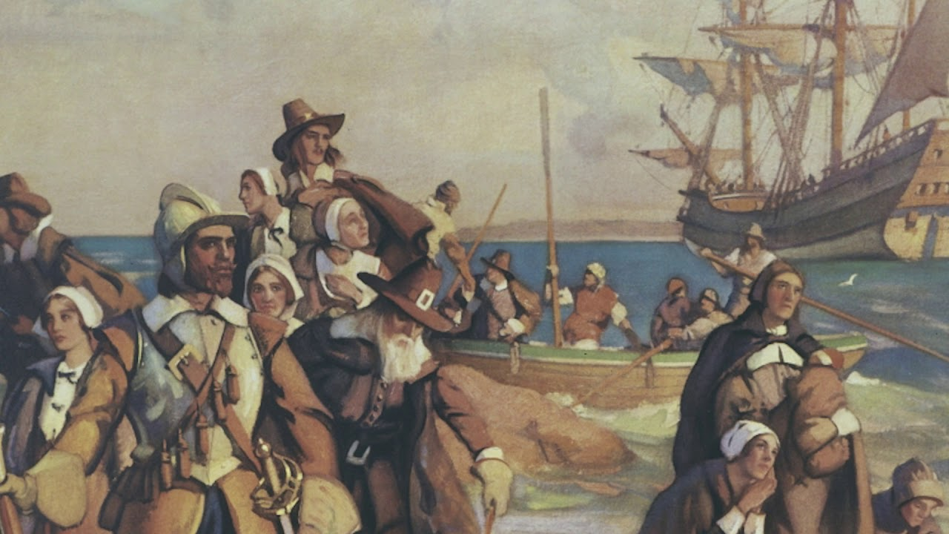

Slide 10
The Danger of Losing
All Sense of Reality
Daniel 5:1

Slide 11
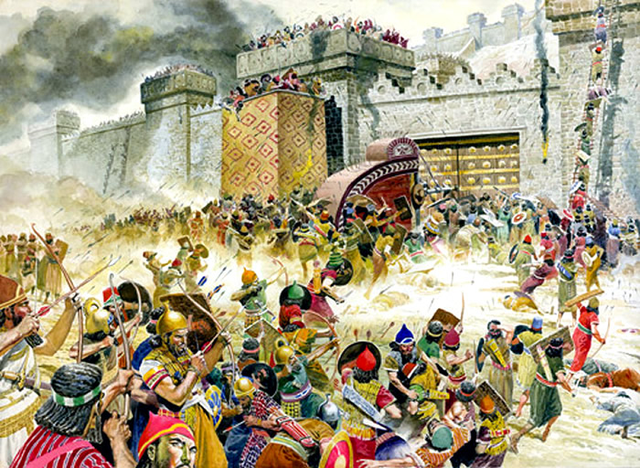

Slide 12
“Let him who thinks he stands take heed lest he also fall”
1 Corinthians 10:12

Slide 13
“God forgive us and
God bless America”

Slide 14
The Danger of Losing
All Sense of Restraint
Daniel 5:2

Slide 15
The Danger of Losing
All Sense of Respect
Daniel 5:3-4

Slide 16


Slide 17
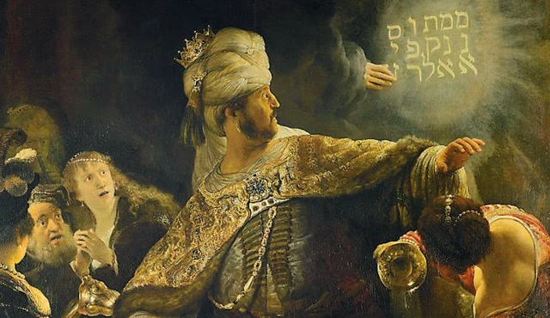

Slide 18
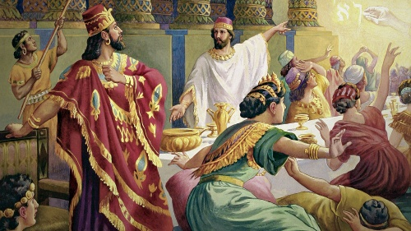

Slide 19
Nebuchadnezzar's power came from God.
Nebuchadnezzar lost his kingdom due to pride.
Nebuchadnezzar was punished.
Nebuchadnezzar's kingdom restored after he realized his power came from God.

Slide 20
“You have not humbled yourself, although you knew all this.”
Daniel 5:22

Slide 21
The decline of any nation stems from spiritual factors.
Everything else is just symptomatic.

Slide 22
Mene, Mene, Tikel, Parin
Numbered, Numbered, Weighted, Separated.

Slide 23
“That very night Belshazzar…was slain and Darius, the Mede, received the kingdom”
Daniel 5:30-31

Slide 24
“The Most High still rules over the affairs of men.”
Daniel 4:32

